Slide 1
Object-Oriented Software Engineering
Practical Software Development using UML and Java
Chapter 8:
Modelling Interactions and Behaviour

Slide 2
8.1 Interaction Diagrams
Interaction diagrams are used to model the dynamic aspects of a software system
  They help you to visualize how the system runs.
  An interaction diagram is often built from a use case and a class diagram.
    The objective is to show how a set of objects accomplish the required interactions with an actor.

Slide 3
Interactions and messages
  Interaction diagrams show how a set of actors and objects communicate with each other to perform:
    The steps of a use case, or
    The steps of some other piece of functionality.
  The set of steps, taken together, is called an interaction.
  Interaction diagrams can show several different types of communication.
    E.g. method calls, messages send over the network
    These are all referred to as messages.

Slide 4
Elements found in interaction diagrams
  Instances of classes
    Shown as boxes with the class and object identifier underlined
  Actors
    Use the stick-person symbol as in use case diagrams
  Messages
    Shown as arrows from actor to object, or from object to object

Slide 5
Creating interaction diagrams
You should develop a class diagram and a use case model before starting to create an interaction diagram.
  There are two kinds of interaction diagrams:
    Sequence diagrams
    Communication diagrams

Slide 6
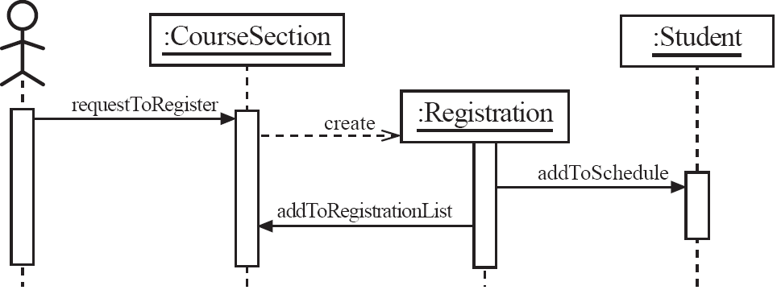
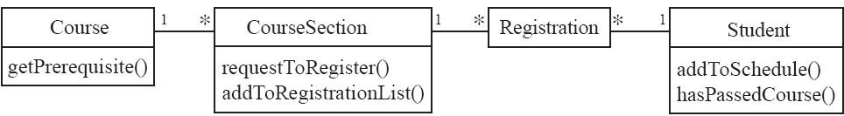
Sequence diagrams – an example

Slide 7
Sequence diagrams
A sequence diagram shows the sequence of messages exchanged by the set of objects performing a certain task
  The objects are arranged horizontally across the diagram.
  An actor that initiates the interaction is often shown on the left.
  The vertical dimension represents time.
  A vertical line, called a lifeline, is attached to each object or actor.
  The lifeline becomes a broad box, called an activation box during the live activation period.
  A message is represented as an arrow between activation boxes of the sender and receiver.
    A message is labelled and can have an argument list and a return value.

Slide 8
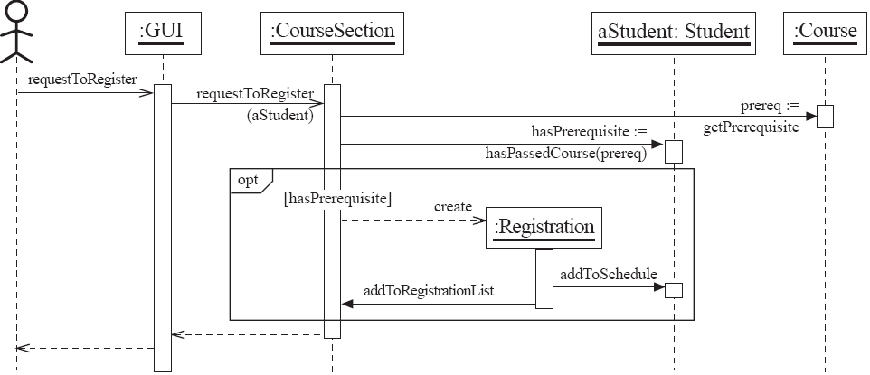
Sequence diagrams – same example, more details

Slide 9
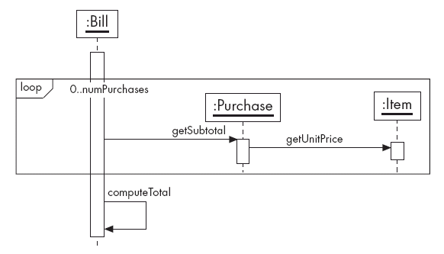
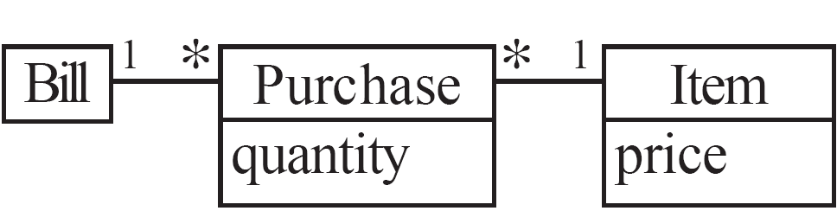
Sequence diagrams – an example with replicated messages
  An iteration over objects is indicated by an asterisk preceding the message name

Slide 10
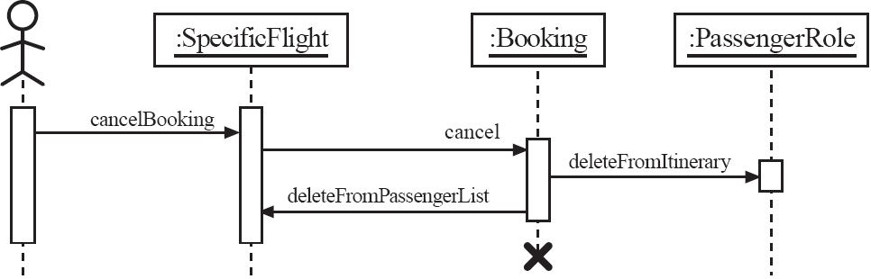
Sequence diagrams – an example with object deletion
  If an object’s life ends, this is shown with an X at the end of the lifeline

Slide 11
Communication diagrams – an example

Slide 12
Communication diagrams
Communication diagrams emphasise how the objects collaborate in order to realize an interaction
  A communication diagram is a graph with the objects as the vertices.
  Communication links are added between objects
  Messages are attached to these links.
    Shown as arrows labelled with the message name
  Time ordering is indicated by prefixing the message with some numbering scheme.

Slide 13
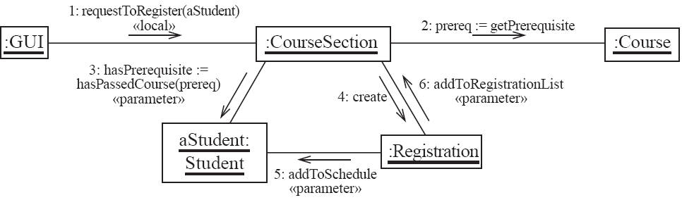
Communication diagrams – same example, more details

Slide 14
Communication links
  A communication link can exist between two objects whenever it is possible for one object to send a message to the other one.
  Several situations can make this message exchange possible:
    1. The classes of the two objects have an association between them.
      This is the most common case.
      If all messages are sent in the same direction, then probably the association can be made unidirectional.

Slide 15
Other communication links
    2. The receiving object is stored in a local variable of the sending method.
      This often happens when the object is created in the sending method or when some computation returns an object .
      The stereotype to be used is «local» or [L].
    3. A reference to the receiving object has been received as a parameter of the sending method.
      The stereotype is «parameter» or [P].

Slide 16
Other communication links
    4. The receiving object is global.
      This is the case when a reference to an object can be obtained using a static method.
      The stereotype «global», or a [G] symbol is used in this case.
    5. The objects communicate over a network.
      We suggest to write «network».

Slide 17
How to choose between using a sequence or communication diagram
Sequence diagrams
  Make explicit the time ordering of the interaction.
    Use cases make time ordering explicit too
    So sequence diagrams are a natural choice when you build an interaction model from a use case.
  Make it easy to add details to messages.
    Communication diagrams have less space for this

Slide 18
How to choose between using a sequence or communication diagram
Communication diagrams
  Can be seen as a projection of the class diagram
    Might be preferred when you are deriving an interaction diagram from a class diagram.
    Are also useful for validating class diagrams.

Slide 19
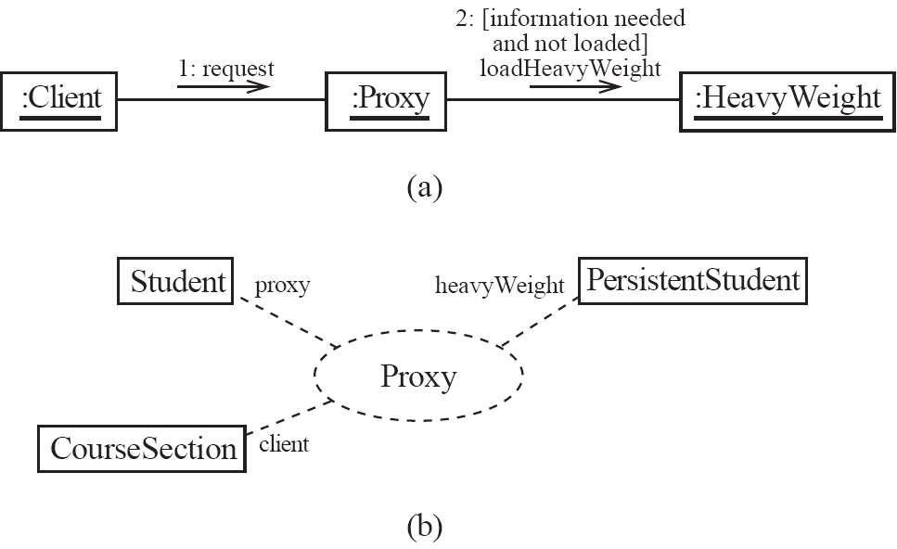
Communication diagrams and patterns
A communication diagram can be used to represent aspects of a design pattern

Slide 20
8.2 State Diagrams
A state diagram describes the behaviour of a system, some part of a system, or an individual object.
  At any given point in time, the system or object is in a certain state.
    Being in a state means that it is will behave in a specific way in response to any events that occur.
  Some events will cause the system to change state.
    In the new state, the system will behave in a different way to events.
  A state diagram is a directed graph where the nodes are states and the arcs are transitions.

Slide 21
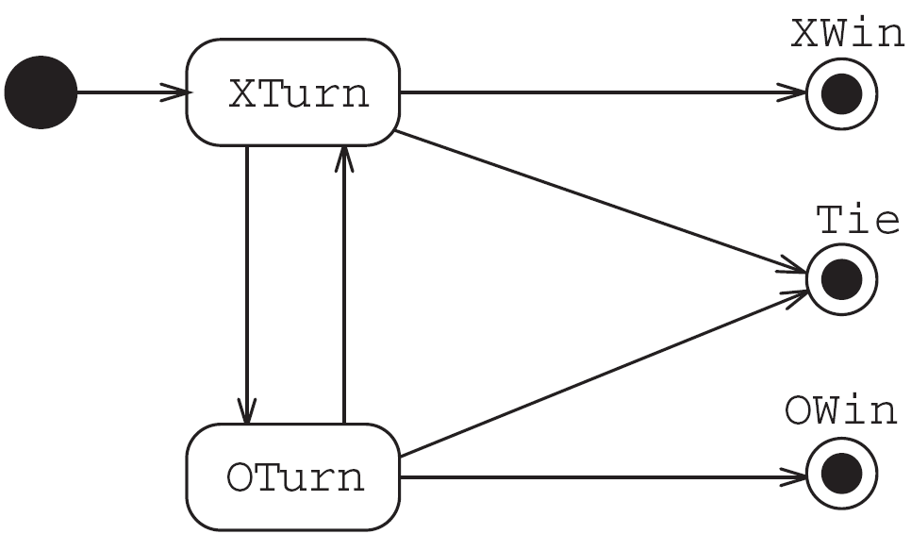
State diagrams – an example
  tic-tac-toe game (also called noughts and crosses)

Slide 22
States
  At any given point in time, the system is in one state.
  It will remain in this state until an event occurs that causes it to change state.
  A state is represented by a rounded rectangle containing the name of the state.
  Special states:
    A black circle represents the start state
    A circle with a ring around it represents an end state

Slide 23
Transitions
  A transition represents a change of state in response to an event.
    It is considered to occur instantaneously.
  The label on each transition is the event that causes the change of state.

Slide 24
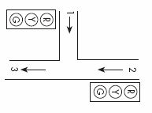
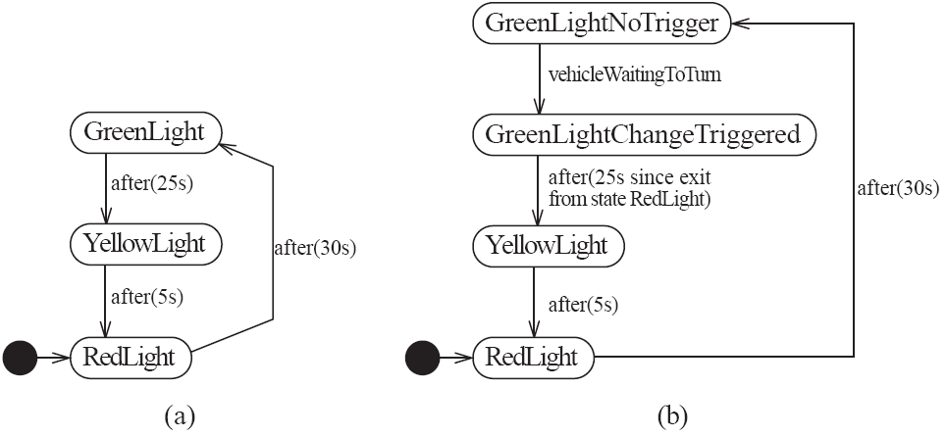
State diagrams – an example of transitions with time-outs and conditions

Slide 25
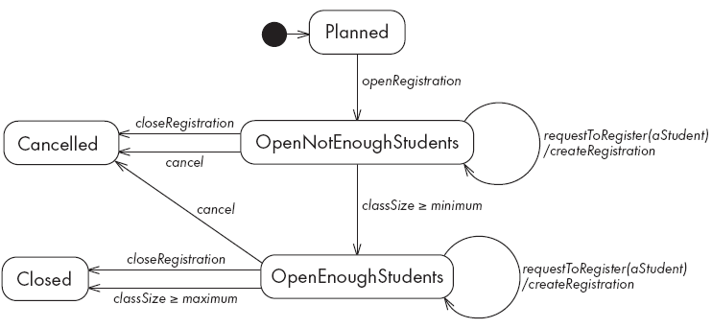
State diagrams – an example with conditional transitions

Slide 26
Activities in state diagrams
  An activity is something that takes place while the system is in a state.
    It takes a period of time.
    The system may take a transition out of the state in response to completion of the activity,
    Some other outgoing transition may result in:
      The interruption of the activity, and
      An early exit from the state.

Slide 27
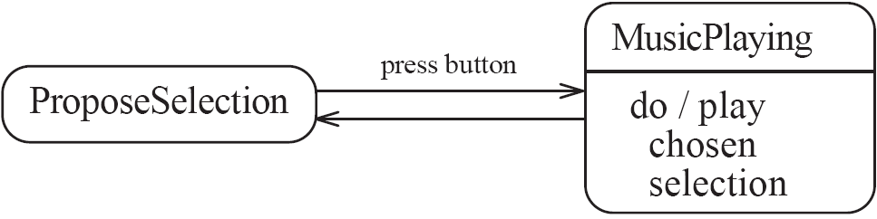
State diagram – an example with activity

Slide 28
Actions in state diagrams
  An action is something that takes place effectively instantaneously
    When a particular transition is taken,
    Upon entry into a particular state, or
    Upon exit from a particular state
  An action should consume no noticeable amount of time

Slide 29
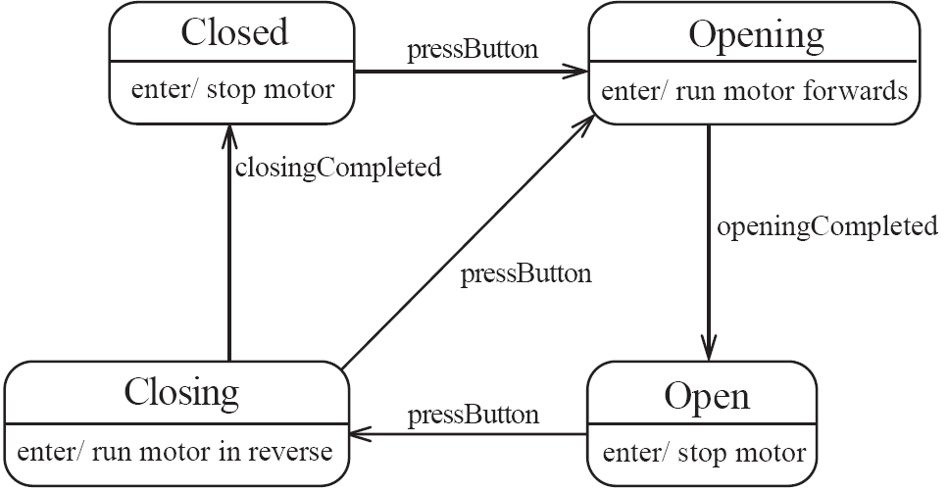
State diagram – an example with actions

Slide 30
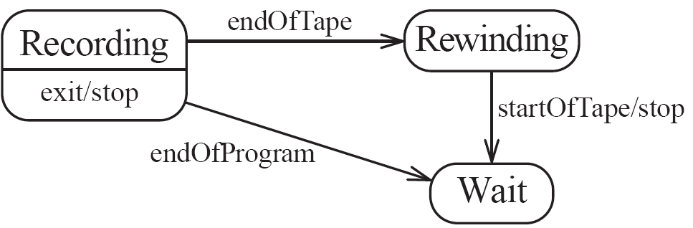
State diagrams – another example

Slide 31
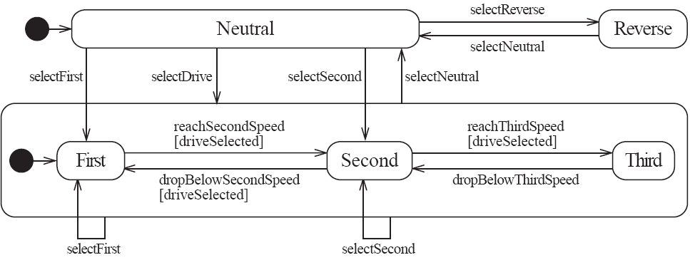
Nested substates and guard conditions
A state diagram can be nested inside a state.
  The states of the inner diagram are called substates.

Slide 32
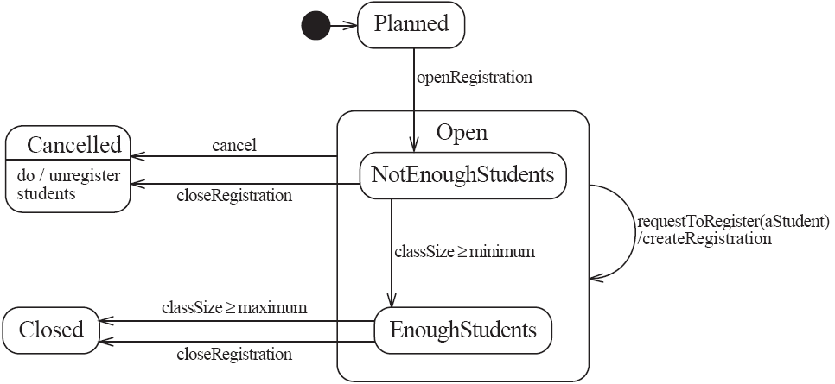
State diagram – an example with substates

Slide 33
8.3 Activity Diagrams
  An activity diagram is like a state diagram.
    Except most transitions are caused by internal events, such as the completion of a computation.
  An activity diagram
    Can be used to understand the flow of work that an object or component performs.
    Can also be used to visualize the interrelation and interaction between different use cases.
    Is most often associated with several classes.
  One of the strengths of activity diagrams is the representation of concurrent activities.

Slide 34
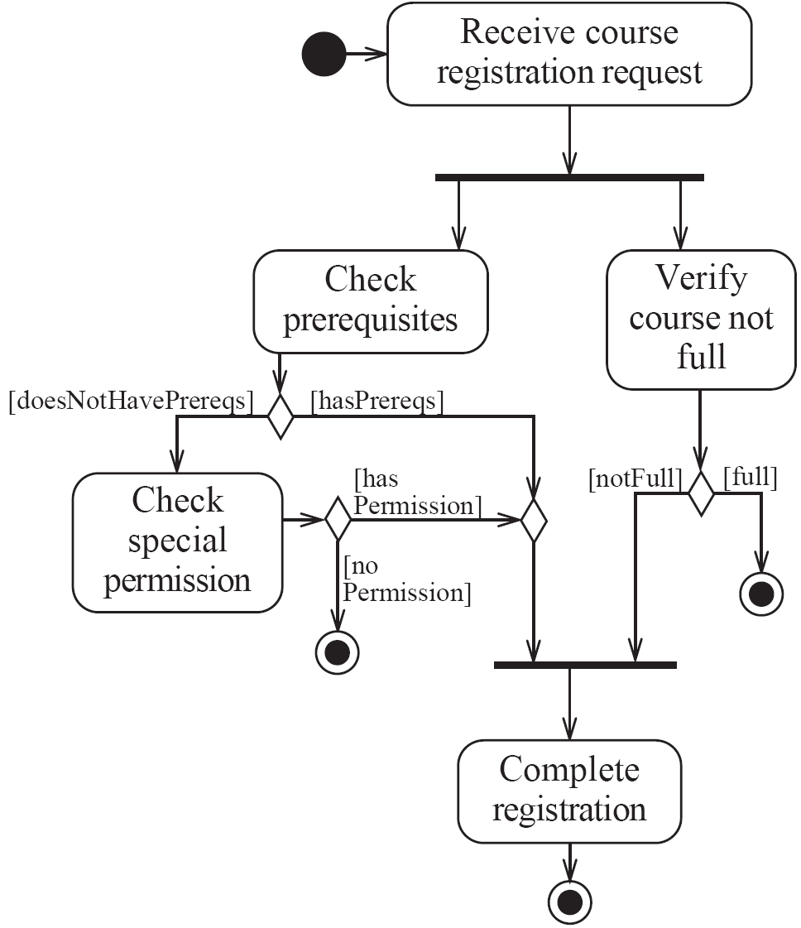
Activity diagrams – an example

Slide 35
Representing concurrency
  Concurrency is shown using forks, joins and rendezvous.
    A fork has one incoming transition and multiple outgoing transitions.
      The execution splits into two concurrent threads.
    A rendezvous has multiple incoming and multiple outgoing transitions.
      Once all the incoming transitions occur all the outgoing transitions may occur.

Slide 36
Representing concurrency
    A join has multiple incoming transitions and one outgoing transition.
      The outgoing transition will be taken when all incoming transitions have occurred.
      The incoming transitions must be triggered in separate threads.
      If one incoming transition occurs, a wait condition occurs at the join until the other transitions occur.

Slide 37
Swimlanes
Activity diagrams are most often associated with several classes.
  The partition of activities among the existing classes can be explicitly shown using swimlanes.

Slide 38
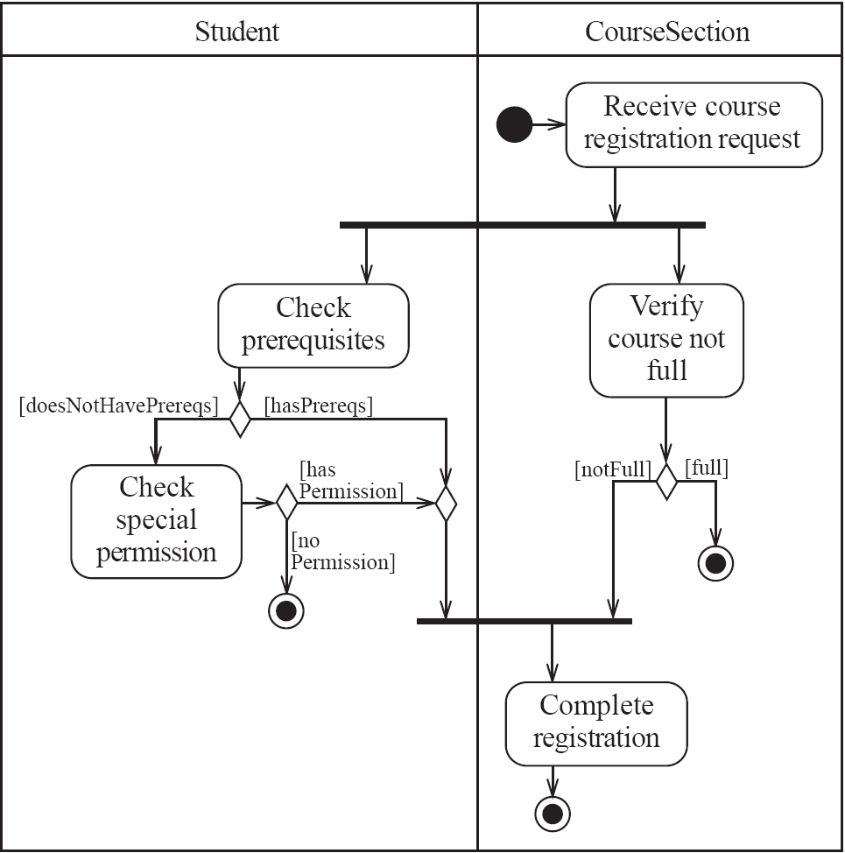
Activity diagrams – an example with swimlanes

Slide 39
8.4 Implementing Classes Based on Interaction and State Diagrams
  You should use these diagrams for the parts of your system that you find most complex.
    I.e. not for every class
  Interaction, activity and state diagrams help you create a correct implementation.
  This is particularly true when behaviour is distributed across several use cases.
    E.g. a state diagram is useful when different conditions cause instances to respond differently to the same event.

Slide 40
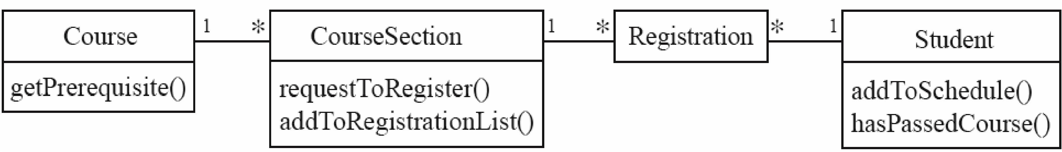
Example

Slide 41
Example: The CourseSection class
States:
  ‘Planned’:
    closedOrCancelled == false && open == false
  ‘Cancelled’:
    closedOrCancelled == true &&
    registrationList.size() == 0
  ‘Closed’ (course section is too full, or being taught):
    closedOrCancelled == true &&
    registrationList.size() > 0

Slide 42
Example: The CourseSection class
States:
  ‘Open’ (accepting registrations):
    open == true
  ‘NotEnoughStudents’ (substate of ‘Open’):
    open == true &&
    registrationList.size() < course.getMinimum()
  ‘EnoughStudents’ (substate of ‘Open’):
    open == true &&
    registrationList.size() >= course.getMinimum()

Slide 43
Example: The CourseSection class
public class CourseSection
{
// The many-1 abstraction-occurrence association (Figure 8.2)
private Course course;
// The 1-many association to class Registration (Figure 8.2)
private List registrationList;
// The following are present only to determine the state
// (as in Figure 8.19). The initial state is 'Planned‘
private boolean open = false;
private boolean closedOrCanceled = false;

Slide 44
Example: The CourseSection class
public CourseSection(Course course)
{
this.course = course;
registrationList = new LinkedList();
}
public void openRegistration()
{
if(!closedOrCanceled) // must be in 'Planned' state
{
open = true; // to 'OpenNotEnoughStudents' state
}
}

Slide 45
Example: The CourseSection class
public void closeRegistration()
{
// to 'Canceled' or 'Closed' state
open = false;
closedOrCanceled = true;
if (registrationList.size() < course.getMinimum())
{
unregisterStudents(); // to 'Canceled' state
}
}
public void cancel()
{
// to 'Canceled' state
open = false;
closedOrCanceled = true;
unregisterStudents();
}

Slide 46
Example: The CourseSection class
public void requestToRegister(Student student)
{
if (open) // must be in one of the two 'Open' states
{
// The interaction specified in the sequence diagram of Figure 8.4
Course prereq = course.getPrerequisite();
if (student.hasPassedCourse(prereq))
{
// Indirectly calls addToRegistrationList
new Registration(this, student);
}
// Check for automatic transition to 'Closed' state
if (registrationList.size() >= course.getMaximum())
{
// to 'Closed' state
open = false;
closedOrCanceled = true;
}
}
}

Slide 47
Example: The CourseSection class
// Private method to remove all registrations
// Activity associated with 'Canceled' state.
private void unregisterStudents()
{
Iterator it = registrationList.iterator();
while (it.hasNext())
{
Registration r = (Registration)it.next();
r.unregisterStudent();
it.remove();
}
}
// Called within this package only, by the constructor of
// Registration to ensure the link is bi-directional
void addToRegistrationList(Registration newRegistration)
{
registrationList.add(newRegistration);
}
}

Slide 48
8.5 Difficulties and Risks in Modelling Interactions and Behaviour
Dynamic modelling is a difficult skill
  In a large system there are a very large number of possible paths a system can take.
  It is hard to choose the classes to which to allocate each behaviour:
    Ensure that skilled developers lead the process, and ensure that all aspects of your models are properly reviewed.
    Work iteratively:
      Develop initial class diagrams, use cases, responsibilities, interaction diagrams and state diagrams;
      Then go back and verify that all of these are consistent, modifying them as necessary.
    Drawing different diagrams that capture related, but distinct, information will often highlight problems.

